Slide 1
Spanning tree and an application in game “Bridg-it”

Slide 2
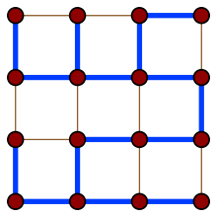
Intro
A spanning tree T is a subgraph such that
is a tree
contains all the vertices
Every connected graph
have a spanning tree

Slide 3
Spanning tree
A spanning tree …
is connected
contains no cycle
there is a unique path between two verteces
have precisely n-1 edges on n verteces
two connected tree formed after removing one edge.

Slide 4
Counting spanning tree
The cardinality of spanning tree is a invariant of graph.
Kirchhoff(1847) find an elegant way to calculate the cardinality of spanning tree of arbitrary graph.

Slide 5

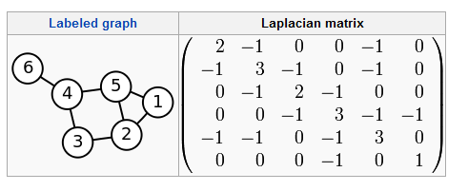
Laplacian matrix
Definition:
Example:

Slide 6
Kirchhoff's theorem
The number of spanning tree is the determinant of Laplacian matrix deleting any row s and any column t multiplied by (-1)^{s+t}.
Property of Laplacian matrix: sum of any row or column is zero.

Slide 7
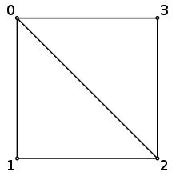
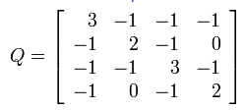

Example 1
det(Q*)=8

Slide 8

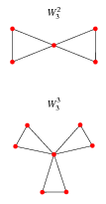
Example 2
Windmill graph
det(L(2k+1|2k+1))=3^{n}

Slide 9

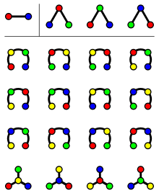
Example 3
Cayley formula: cardinality of complete graph’s K_{n} spanning tree is n^{n-2}.

Slide 10

Sketch of proof
Incidence matrix E:
L=EE^{t}

Slide 11
More on Cayley’s formula
Prufer coding: a bijection from spanning trees and a sequence {(a₁,…,a_{n-2})}(a_{i}∈{1,…,n})
consider a labeled tree T with vertices {1, 2, ..., n}. At step i, remove the leaf with the smallest label and set the i th element of the Prüfer sequence to be the label of this leaf's neighbour.

Slide 12
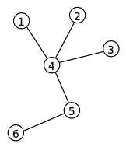
example
A labeled tree with Prüfer sequence {4,4,4,5}.

Slide 13
Why bijection?
By constructing inverse map
Property of Prüfer sequence: leaf vertex would never appear in Prüfer sequence.
Connect the leaf vertex with smallest number and first number in Prüfer sequence.
Maintain an array of degree to predict next leaf vertex
Do this iteratively.

Slide 14
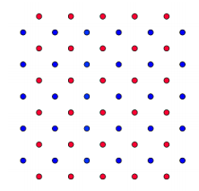
Game Bridg-It

Slide 15
Game Bridg-It
Players take turns connecting two adjacent dots of their own color with a bridge. Adjacent dots are considered to be dots directly above, below, to the right, or to the left of another dot with the same color. A newly formed bridge cannot cross a bridge already played and whoever connects their opposite edges of the board first wins.
There are always a winner.

Slide 16
Who wins in Bridg-it?
Theorem: Player 1 has a winning strategy in Bridg-it.
Proof: Strategy Stealing.
Suppose Player 2 has a winning strategy.
Then here is a winning strategy for Player 1:
Start with an arbitrary move and then pretend to be Player 2 and play according to Player 2’s winning strategy. If this strategy calls for the ﬁrst move of yours, again select an arbitrary edge. Etc...

Slide 17
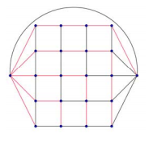
Towards an explicit strategy
The game is equivalent with “short and cut” game on such a graph:

Slide 18
power of spanning tree
Such graph can be decomposed into two edge-disjoint spanning tree
idea for winning strategy: when player2 cuts an edge in one spanning tree, we reconnect it using edges from another tree.
we remove the edge that player2 cut and combine the vertices that player1 short.
So we can always have two edge-disjoint spanning tree

Slide 19
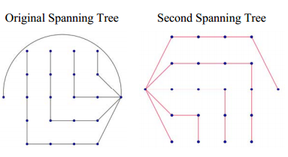
Two edge-disjoint tree

Slide 20
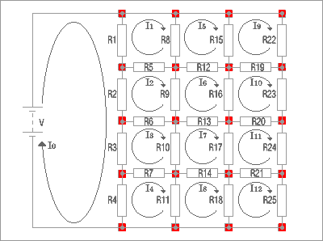
An interesting sub-optimal strategy
Consider a circuit:
A “vital ” move should have highest current flow through it.

Slide 21
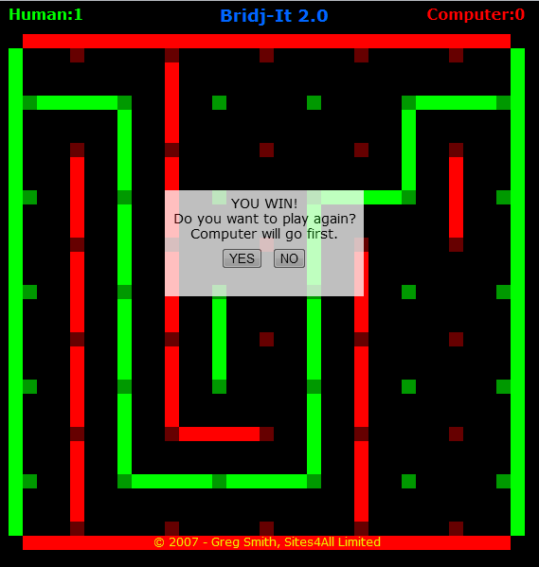
I win!!

Slide 22
Thank you!!

